Slide 1
Impulse and Momentum in a Rigid Body
Dr. Jacob Moore
Associate Professor of Engineering
Penn State Mont Alto

Slide 2
Impulse and Momentum in Rigid Bodies
As we have seen before, when we move from particle systems to rigid body systems, we will need to not only deal with forces, positions, velocities, and accelerations, but we will also need to deal with moments, orientations, angular velocities, and angular accelerations.
This remains the case with impulse-momentum methods, where we will add a rotational counterpart to the translational impulse-momentum equation.

Slide 3
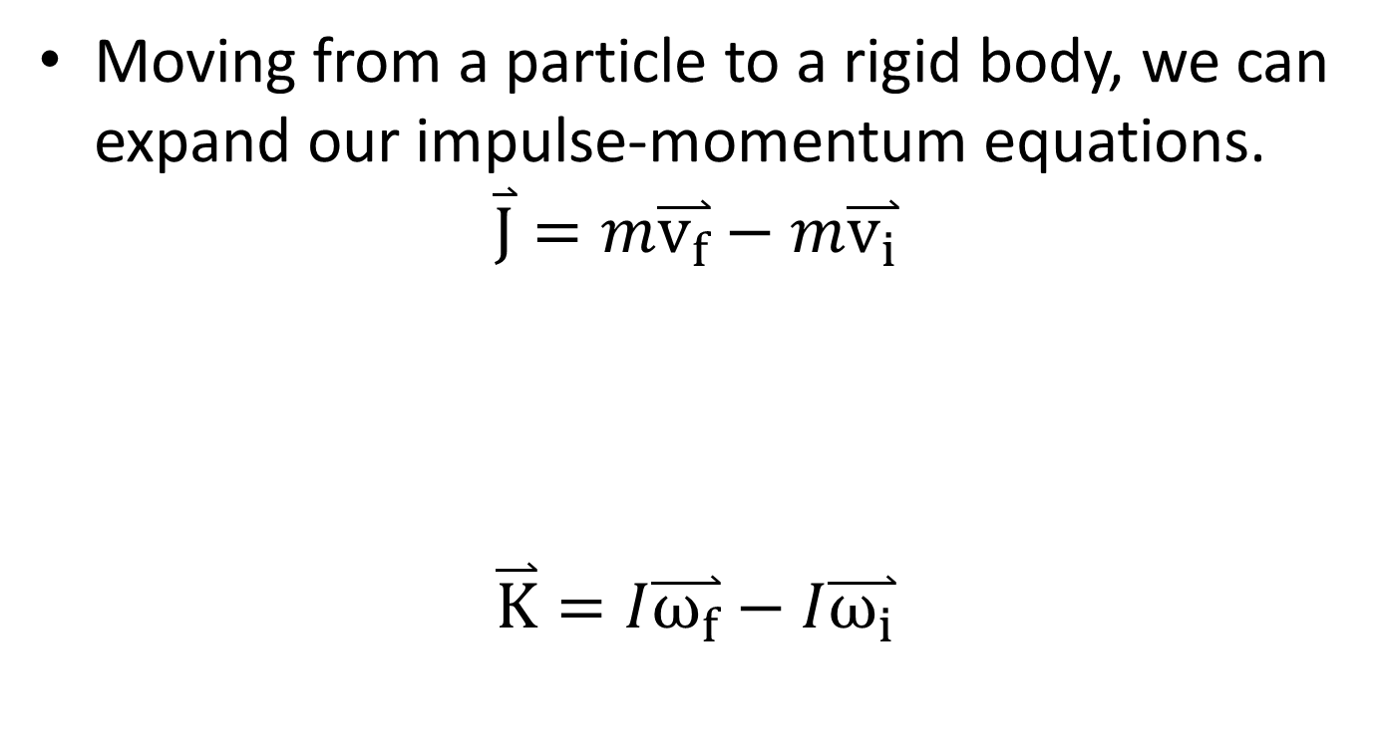
Impulse and Momentum in a Rigid Body
Moving from a particle to a rigid body, we can expand our impulse-momentum equations.
$$\overset{⃑}{J}=m\overset{⃑}{v_{f}}−m\overset{⃑}{v_{i}}$$
$$\overset{⃑}{K}=I\overset{⃑}{ω_{f}}−I\overset{⃑}{ω_{i}}$$
Impulse
Initial Momentum
Final Momentum
Angular
Impulse
Initial Angular Momentum
Final Angular Momentum

Slide 4
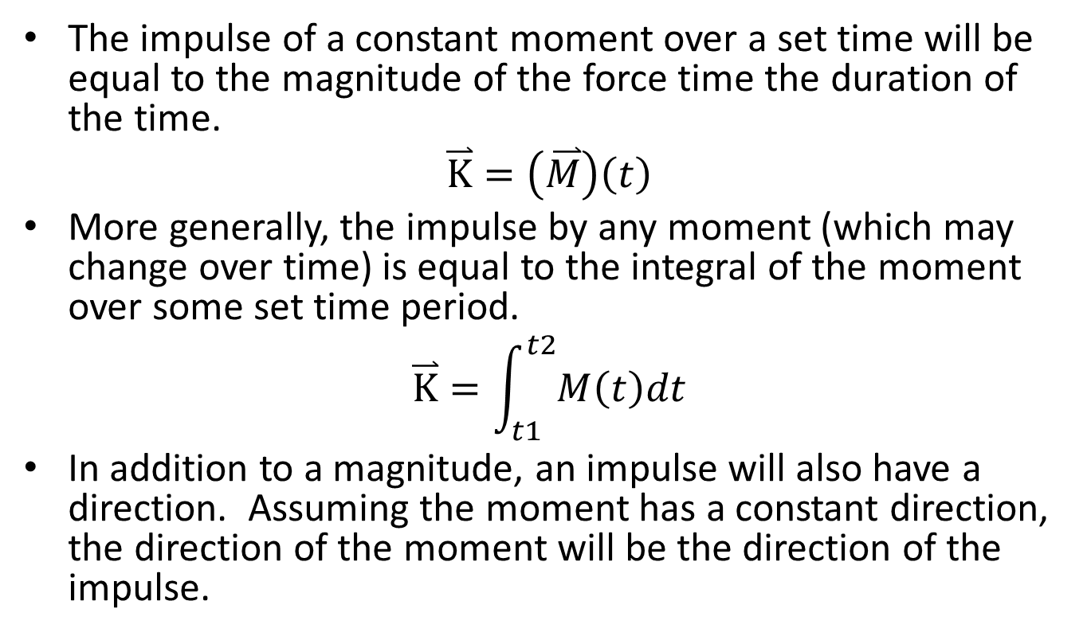
Impulse of a Moment
The impulse of a constant moment over a set time will be equal to the magnitude of the force time the duration of the time.
$$\overset{⃑}{K}=\left(\overset{⃑}{M}\right)\left(t\right)$$
More generally, the impulse by any moment (which may change over time) is equal to the integral of the moment over some set time period.
$$\overset{⃑}{K}=\int_{t1}^{t2}{M\left(t\right)dt}$$
In addition to a magnitude, an impulse will also have a direction. Assuming the moment has a constant direction, the direction of the moment will be the direction of the impulse.

Slide 5
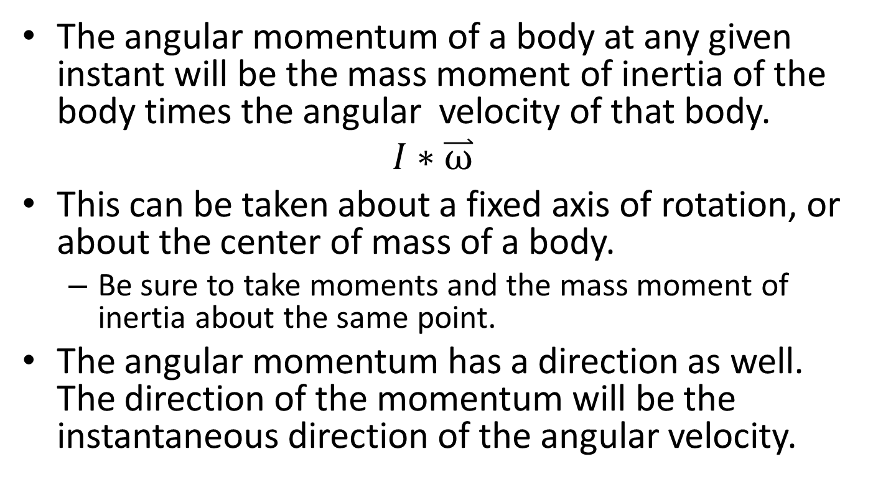
Angular Momentum
The angular momentum of a body at any given instant will be the mass moment of inertia of the body times the angular velocity of that body.
$$I∗\overset{⃑}{ω}$$
This can be taken about a fixed axis of rotation, or about the center of mass of a body.
Be sure to take moments and the mass moment of inertia about the same point.
The angular momentum has a direction as well. The direction of the momentum will be the instantaneous direction of the angular velocity.

Slide 6
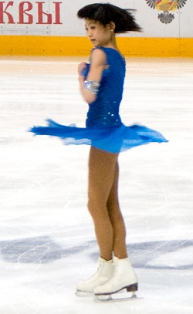
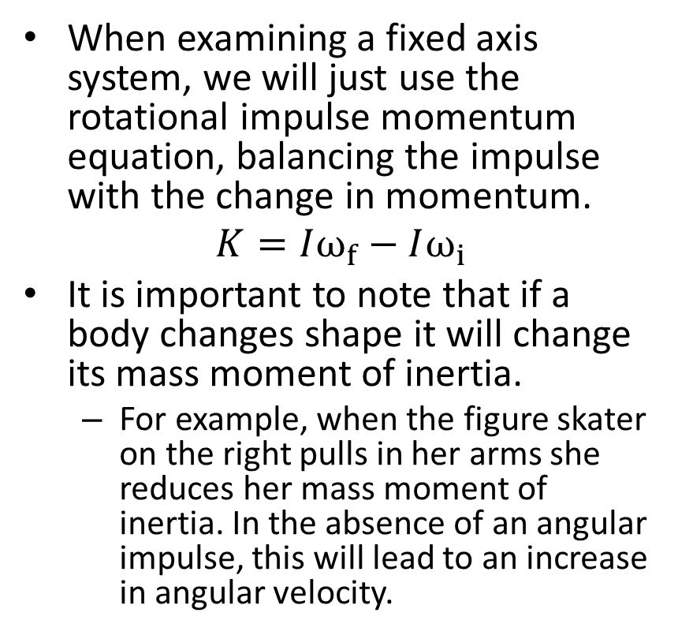
Fixed Axis Rotation with the Impulse Momentum Equations
When examining a fixed axis system, we will just use the rotational impulse momentum equation, balancing the impulse with the change in momentum.
$$K=Iω_{f}−Iω_{i}$$
It is important to note that if a body changes shape it will change its mass moment of inertia.
For example, when the figure skater on the right pulls in her arms she reduces her mass moment of inertia. In the absence of an angular impulse, this will lead to an increase in angular velocity.
Public Domain image by deerstop

Slide 7
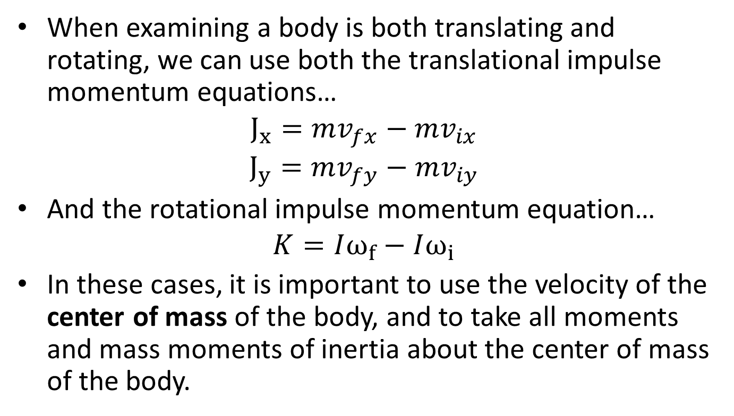
General Planar Motion with the Impulse Momentum Equations
When examining a body is both translating and rotating, we can use both the translational impulse momentum equations…
$$J_{x}=mv_{fx}−mv_{ix}$$
$$J_{y}=mv_{fy}−mv_{iy}$$
And the rotational impulse momentum equation…
$$K=Iω_{f}−Iω_{i}$$
In these cases, it is important to use the velocity of the center of mass of the body, and to take all moments and mass moments of inertia about the center of mass of the body.

Slide 8
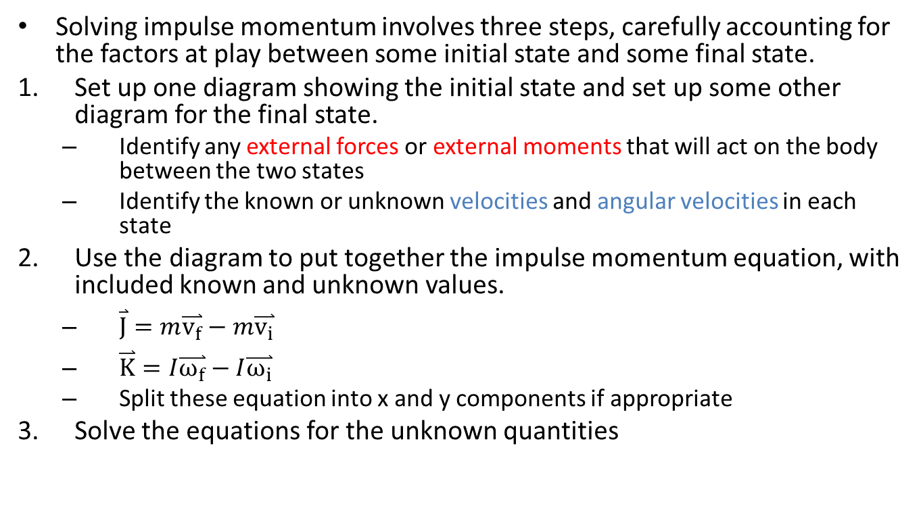
Solving a Impulse Momentum Problem (The Process)
Solving impulse momentum involves three steps, carefully accounting for the factors at play between some initial state and some final state.
Set up one diagram showing the initial state and set up some other diagram for the final state.
Identify any external forces or external moments that will act on the body between the two states
Identify the known or unknown velocities and angular velocities in each state
Use the diagram to put together the impulse momentum equation, with included known and unknown values.
$\overset{⃑}{J}=m\overset{⃑}{v_{f}}−m\overset{⃑}{v_{i}}$
$\overset{⃑}{K}=I\overset{⃑}{ω_{f}}−I\overset{⃑}{ω_{i}}$
Split these equation into x and y components if appropriate
Solve the equations for the unknown quantities

Slide 9
Thanks for Watching
See other engineering mechanics videos and access the full tool at…

Slide 10
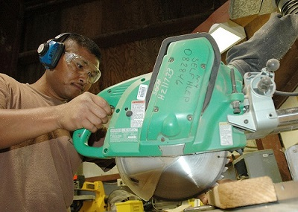
Worked Example
A miter saw has an operating speed of 1500 rpm. The blade and motor armature have a combined weight of 3 lbs and a radius of gyration of 1 inch.
What is the time required for the bearing friction alone (T=.015 in lbs) to stop the blade?
What is the torque a braking system would need to apply to stop the blade in just .25 seconds?
Public domain image by John F. Looney

Slide 11
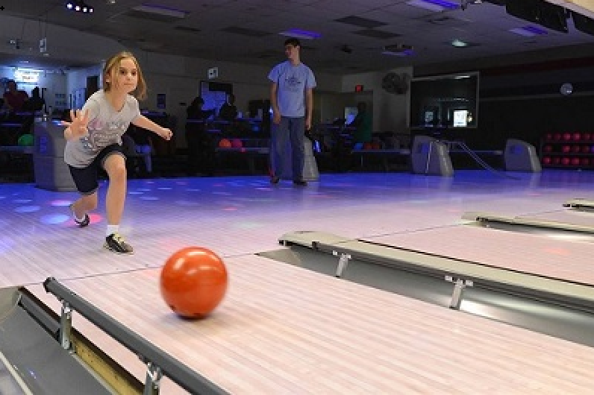
Worked Example
A bowling ball is modeled as a 7 kg uniform sphere 300 mm in diameter. The ball is released with an initial velocity of 6m/s on a horizontal wooden floor (𝜇_{k}=.1) with zero angular velocity.
How long does it take before the ball begins to roll without slipping?
What is linear velocity of the ball at this time?
Public domain image by Jerry Saslav

Slide 12
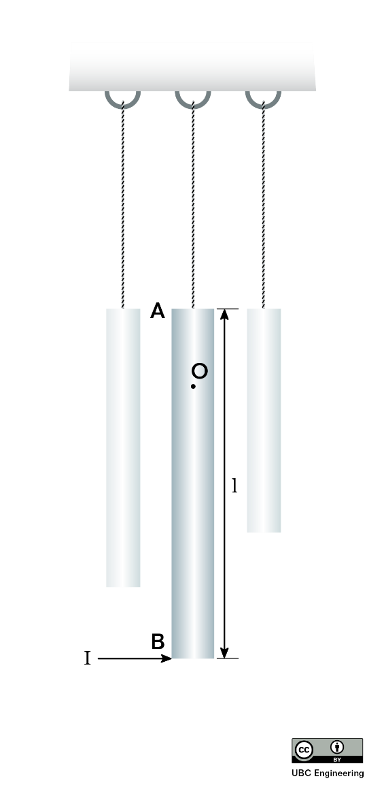
Worked Example
A windchime consists of several slender rods, each suspended on one end by a rope and each with mass m. Consider a singular rod for this problem. As the wind blows, the rod is subjected to an impulse I at its bottom. Determine the vertical location of point O in which the rod appears to rotate.

Slide 13
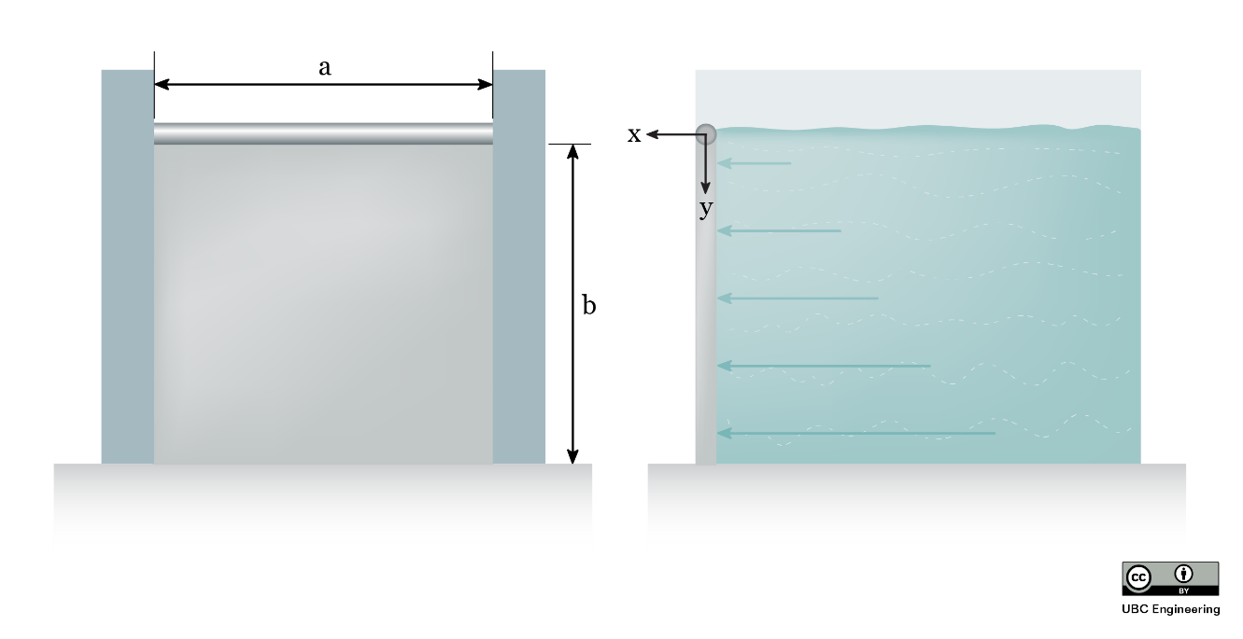
Worked Example
A salmon hatchery has a gate to release water whenever water levels get too high. The gate is normally locked into place, but when the water reaches. The top of the gate, the lock is instantly removed. While the water would flow out of the gate by itself, there is a pump located upstream from the gate to push water forward. The pump is old, so its power slowly ramps up with time. The gate consists of a slender rod in which a 20 kg thin plate is attached. The plate has dimensions a=1.5 m,b=2 m and rotates about the slender rod as if it were a pin. Although there is a seal such that water may not get out, assume the contact between the plate and other surfaces is frictionless. If the gate is subject to water from the pump that applies a force distribution with a magnitude that is related to both the y-coordinate and time dF=(-t(y-2)^2+8t) dy N, determine the angular velocity of the gate after t=2 seconds if the gate initially starts at rest.

Slide 14
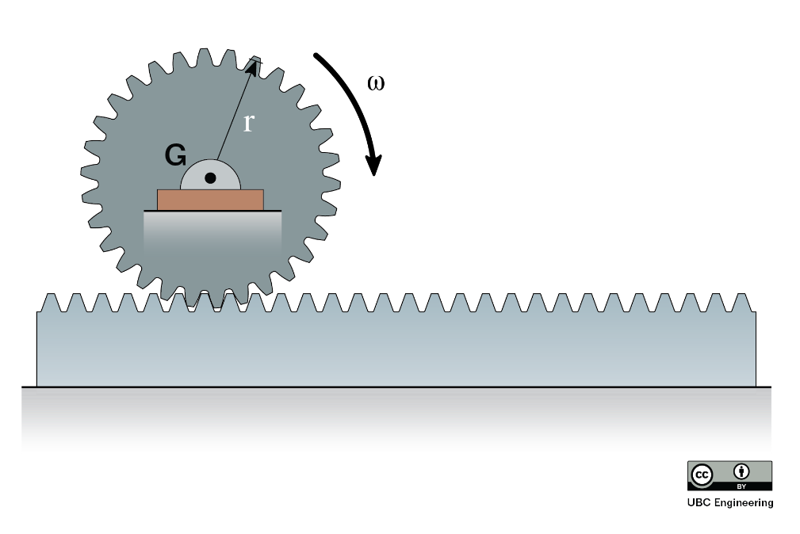
Worked Example
A city engineer is working on a cargo transport system utilizing gears and racks. She is considering a 30 kg gear with a radius of gyration of k_{G} = 125 mm and a radius of r = 0.15 m. The gear is in contact with a 20 kg rack. If it takes the gear 0.6125 s to reach an angular velocity of ω = 20 rad/s, starting from rest, determine the moment that the gear is subjected to. Assume there is no friction between the rack and the ground.

Slide 15
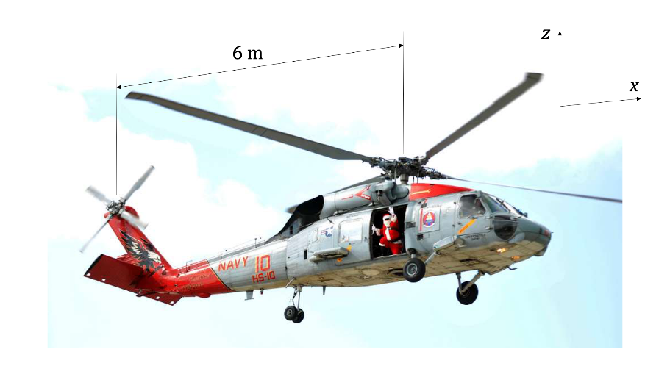
Worked Example
A helicopter tail rotor is used to prevent unwanted rotation of the body of the helicopter when the main rotor changes speed. Assume that the four main rotor blades are each long thin rods with length of 5 m and mass of 30 kg. Assume that the helicopter body has a mass of 750 kg and a mass moment of inertia of 1300 kg-m² at its center of gravity, located vertically in line with the main rotor. The distance between the main and tail rotors is 6 m.
If the tail rotor is functioning, and the angular velocity of the helicopter body remains at zero before and after the main rotor changes speed from 200 rpm to 300 rpm, find the final horizonal velocity of the helicopter body (starts from rest).
Assuming the main rotor change in speed from 200 rpm to 300 rpm occurs in uniformly over 8 s, find the force exerted by the tail rotor to keep the helicopter body from turning.

